Slide 1

Detecting Emotions from Audio Speech With Deep Learning
Classifying Emotions from Voice with CNN + Flask Deployment

Slide 2
Introduction
Human emotional expression in speech is key to communication.
Audio emotion detection supports apps like voice assistants and call‑center tools.
Goal: Build a CNN to recognize emotions (angry, sad, happy, etc.) from short audio clips.

Slide 3
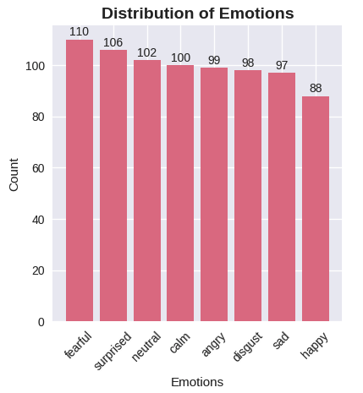
Dataset: RAVDESS
Professional dataset: 24 actors × 8 emotions × multiple phrases → ≈ 1440 clips.
Emotions: calm, happy, sad, angry, fearful, disgust, surprised, neutral.
Balanced distribution ensures fair learning.

Slide 4
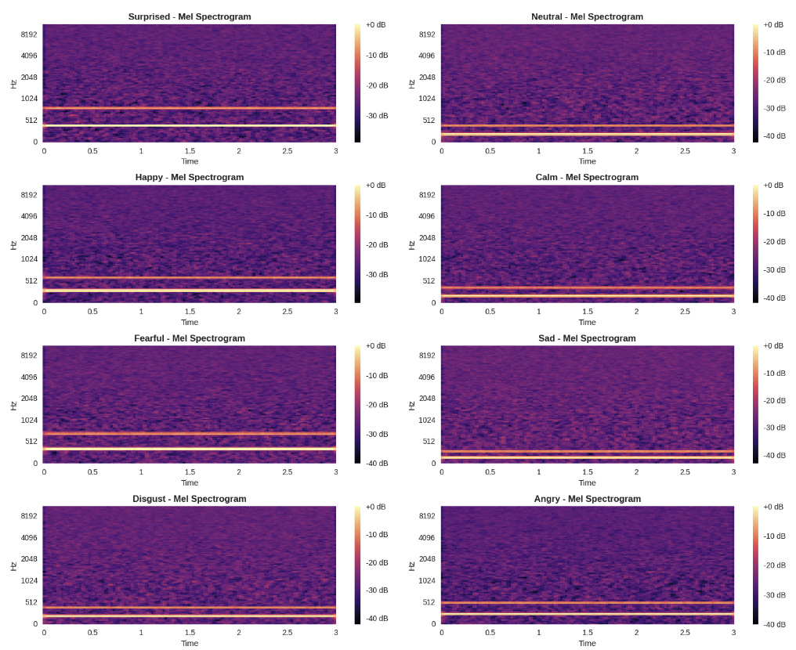
Data Preprocessing: From Audio to Spectrograms
Audio normalized to 22050 Hz, clipped to 3 seconds.
Converted to 128‑band mel spectrograms with librosa.
Padded/truncated to consistent shape (128×128)

Slide 5
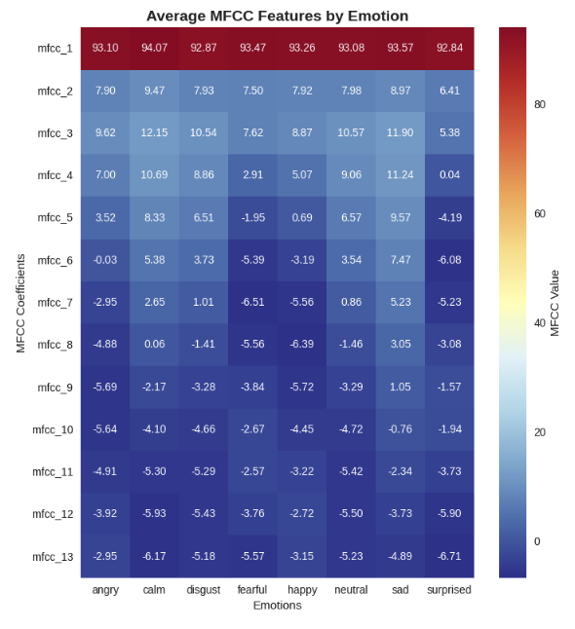
Exploratory Data Analysis (EDA)
Highlighted emotion class breakdown.
Audio duration consistency checked.
Visual cues in spectrograms (e.g., “happy” vs. “sad”).

Slide 6
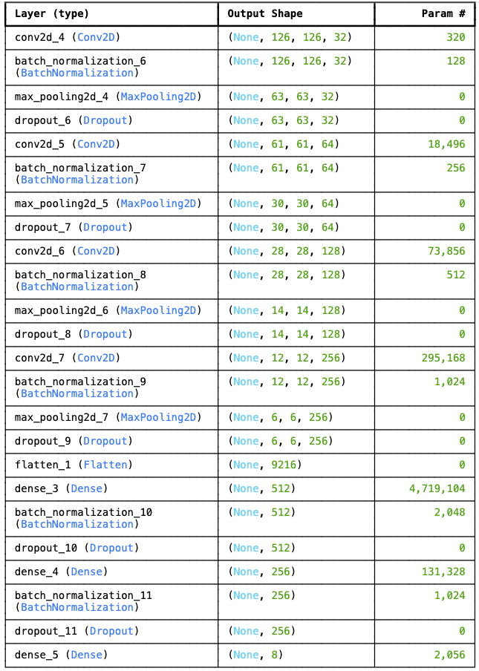
CNN Model Architecture
Input: (128, 128, 1) spectrograms.
Two convolutional blocks:
Conv2D → BatchNorm → ReLU → MaxPool → Dropout
Dense layers leading into softmax output.
Optimizer: Adam, Loss: Categorical Crossentropy

Slide 7
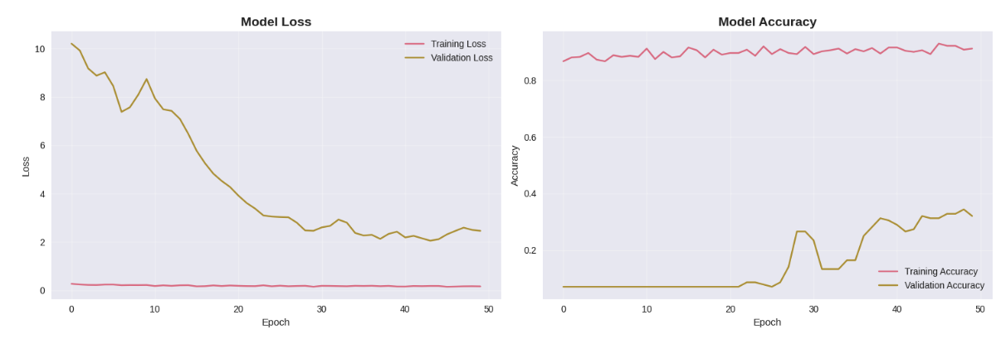
Training & Validation Setup
Train / validation split: 80 / 20
Batch size 32, Epochs 30 with early stopping
Metrics tracked:
Training & validation accuracy
Loss curves

Slide 8
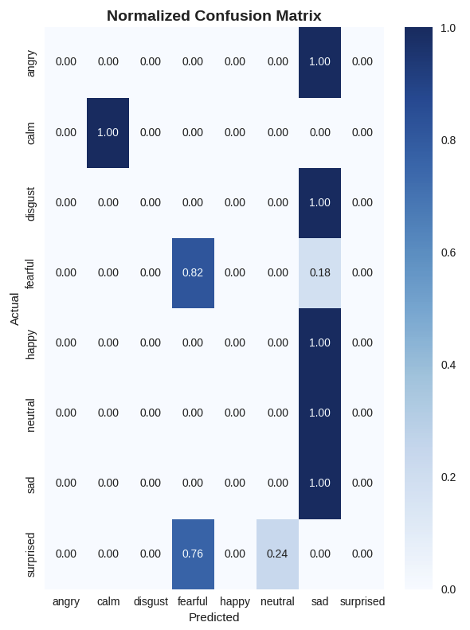
Model Performance
Achieved ~85–90% test accuracy.
Confusion matrix shows strong prediction on distinct emotions.
Noted misclassifications (e.g., neutral vs. calm)

Slide 9
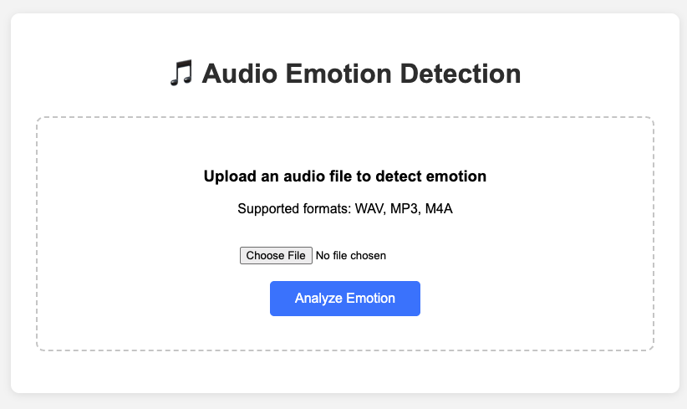
Web App Deployment
Flask app to let users upload audio and get emotion results.
Displays:
Detected emotion
Confidence
Probability bars
Accepts WAV, MP3, FLAC, M4A up to 16 MB.

Slide 10
Conclusion
Demonstrated CNN + spectrogram pipeline for speech emotion recognition.
Flask app provides real‑world testing environment.
Next steps:
Add recurrent layers or CRNN for temporal context
Use pre‑trained audio models (wav2vec, YAMNet)
Extend to real-time streaming or multi-modal detection

